Slide 1
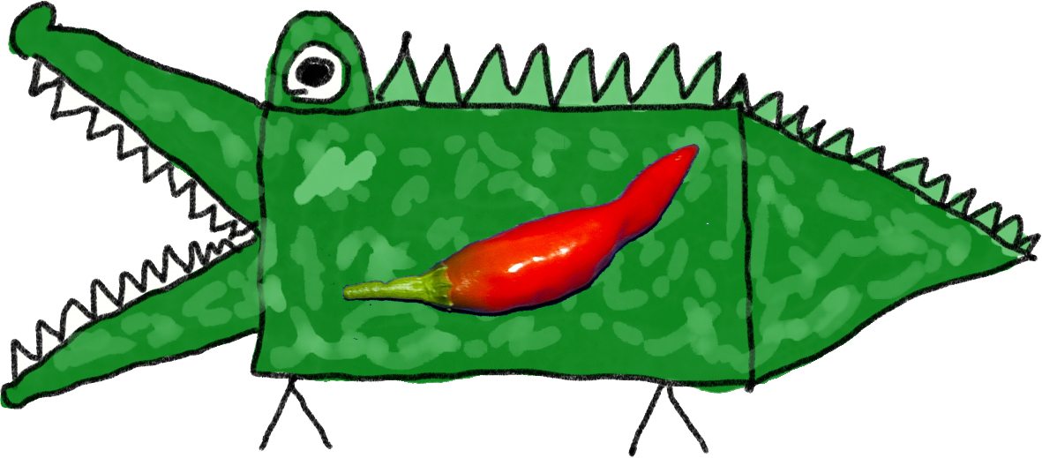
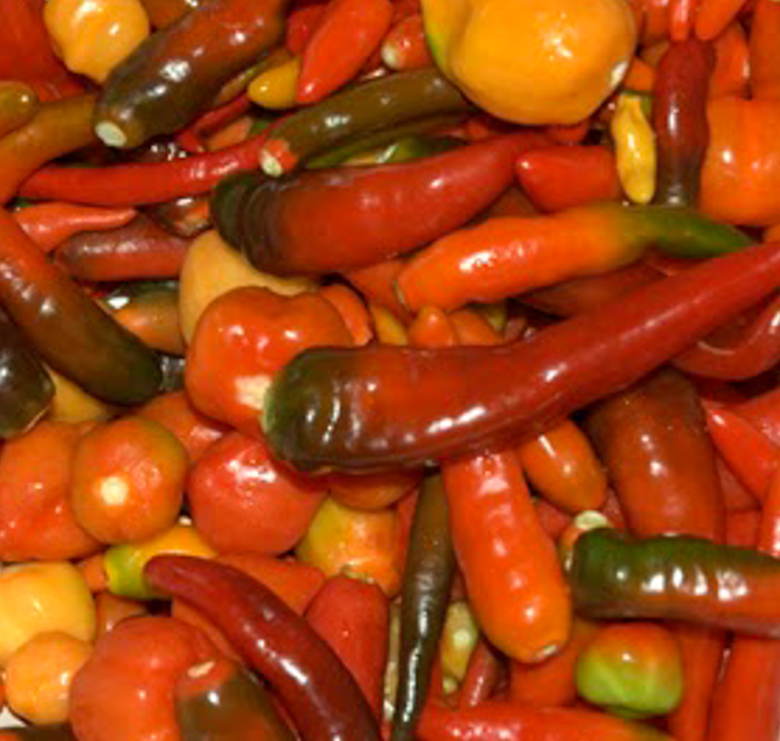
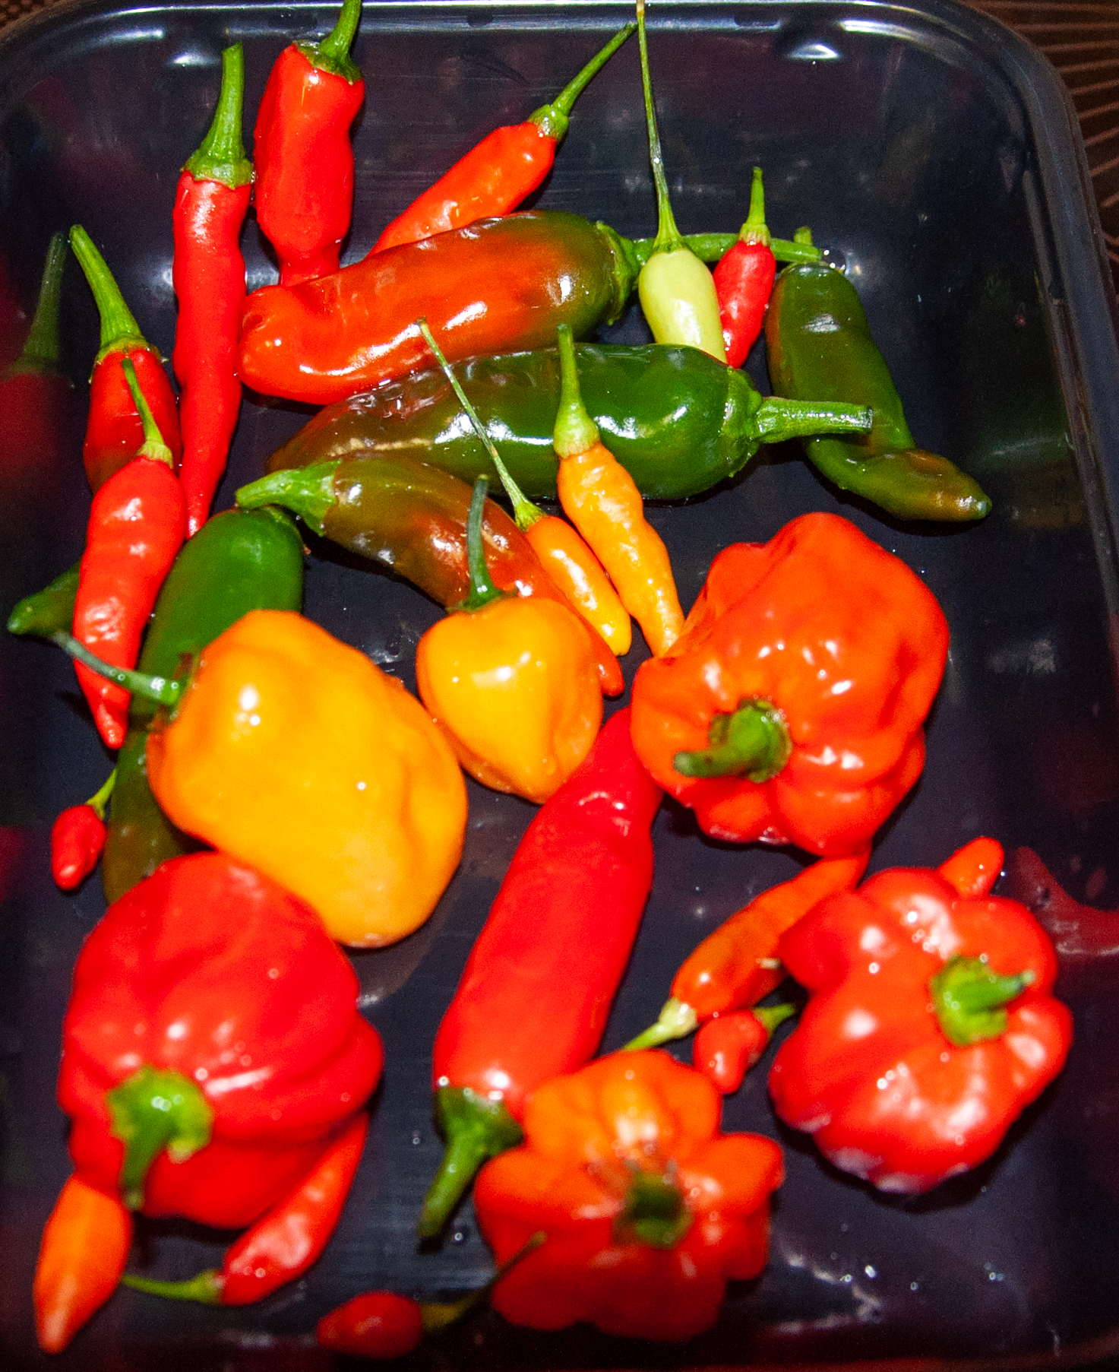
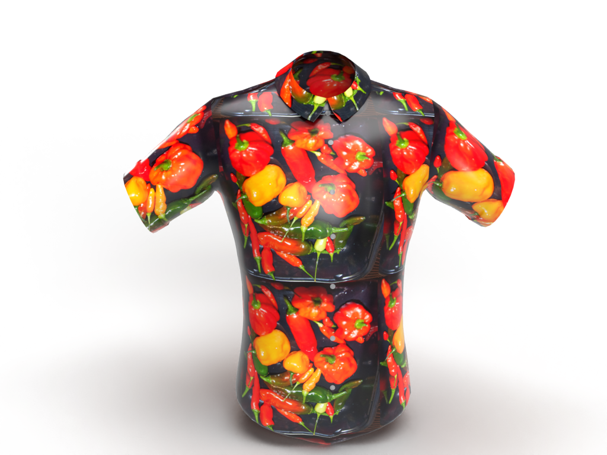
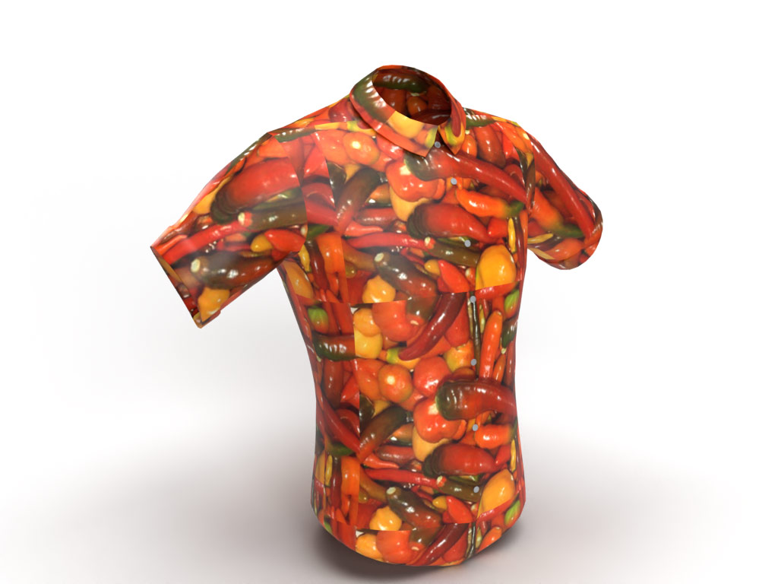
Ideation – A Hot Topic
By Mark Christie
Notes:
I am here today to present a Hot Topic which I hope you can use in your schools…
Ideation, the formation of ideas or concepts is very personal. In an education environment where we might teach ideation we should apply some structure. Ideation should come from a need, a passion something to solve, improve or replace. This presentation will walk through my ideation process from start to end. My intent is to share the process as well as how I use some of the Adobe tools in my journey.
My idea formed when I wanted a chilli Hawaiian shirt. I couldn’t find what I wanted but over the years I had taken many photographs of chilis I had grown.

Slide 2
Ideation - the formation of ideas or concepts.
There should be a need, a passion… something to solve, improve or replace… a starting point.
This story is about my starting point, the desire for a chilli themed Hawaiian shirt.
It sounds almost selfish to be focussing on this, but chillies and shirts have worldwide understanding without the need for explanation.
1000+ Ideation Resources on the Education Exchange –
https://edex.adobe.com/search?q=ideation&type=teaching-resources
The Complete List of Ideation Techniques for Remote Teams (creately.com)
Design Thinking Process | Detailed Look at Design Thinking Steps & Tools (creately.com)
Problem from customer’s view
Generate Ideas
Select
Produce
Notes:
Could I capture this process and sharing so that other teachers and students could adapt it to create something that held their passion?
I researched ideation techniques and looked at the design thinking process and determined there were four key stages.
I had to detail the problem from the customers view. That was quite easy because I was the customer but it meant I had to provide detail and set some parameters and boundaries of what I wanted to create.
With a few rules and boundaries in place, I’ll call them specifications, these specifications gave me the freedom to generate ideas within a defined creation area. By not having idea of a specification, you risk embarking on a never-ending journey where nothing gets created.
Make sure you check out the Adobe Education exchange which has over 1000 learning objects tagged ideation which clearly means it is a hot topic...
Then we select… and produce
Ideation is the creative process of generating, developing, and communicating new ideas, where an idea is understood as a basic element of thought that can be either visual, concrete, or abstract. Ideation comprises all stages of a thought cycle, from innovation, to development, to actualization. Ideation can be conducted by individuals, organizations, or crowds. As such, it is an essential part of the design process, both in education and practice.

Slide 3
Application and Benefits in NT Education
My value proposition for remote multimodal skills education in the Northern Territory and benefits…
Introduces teachers and students to entire material production process
Provides a potential employment pathway for remote participants
Can be contextualised to any personal pattern, image or art object
Introduces teachers and parents to multimedia creation tools
Provides examples of creating digital promotion content from their creations
Demonstrates ways to minimise logistic shipping and reprints
Doesn’t have to be about chillies or shirts…
But mine is!
Notes:
Although iDeation should not be constrained by rules and process, in todays world of plans, budgets, outcomes and benefits it is useful to define benefits for your cohort (even if it is yourself) Here were mine for our Department of Education.

Slide 4
Project Concept and Plan
Objective –
create a real Hawaiian shirt with a chilli pattern and a logo
Constraints, tasks and expectations – my specification
I Must
Use photos of my own chillies I have grown
Make selection from Lightroom photo library shortlist
Save chosen images to CC Libraries so they can be worked on anywhere
Clean up the image edges in Photoshop
Set the image size and resolution for print
Create a seamless pattern in photoshop
design and prototype the pattern on a 3D shirt model chosen from Adobe Stock
Create several pattern mockups to be used in an online web shop or brochure – Dimension and Photoshop
Make final selection for material print
Change the offset on the canvas to match pattern cutting for shirt so that seams match
Design a unique shirt brand logo – Fresco, Photoshop
choose the type of cloth that provides best colour fastness and wearability
Print at least two versions on 20cm squared cloth swatches or on A4 paper to guage look and size
Print a swatch on the selected cloth to confirm colour and print shape/size – repeat until happy – no more than 3 attempts
Print enough material (2 * 1.4m) to make a 2XL Hawaiian Shirt
Notes:
If you don’t have a destination and a map, you may never reach where you are going. Setting a goal, and including what you think or know about tasks needed to get there along with any constraints (money, time, skills, support) into a project concept or plan will give you that roadmap.
In my case the ideas were about creating a number of designs using chilis in a way that could be printed onto cloth and then tailored into a Hawaiian shirt.

Slide 5
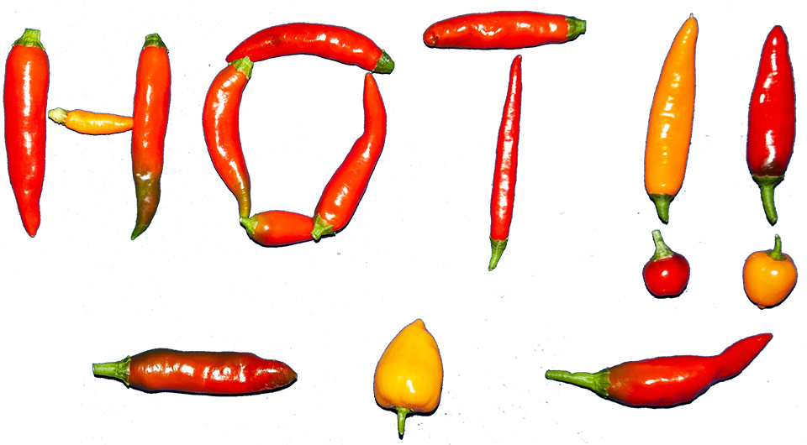
Lightroom
Photograph chillies
Upload to Lightroom
Tag photos and add metadata
…years later
Search for photos tagged chillies
View the thumbnails and make picks or selections
Either move to “cleanup” phase in Photoshop or copy selected files to a work location library and then use Photoshop to clean up the selected files
Assets
Notes:
I use Lightroom to store, tag and select the photographs I thought were the best from the thousands I had taken over the years. Copies of the best of the best were made into a creative cloud library set up specifically for this task.
Let’s see how I did this
----------------------
Photograph chillies
Upload to Lightroom
Tag photos and add metadata
…years later
Search for photos tagged chillies
View the thumbnails and make picks or selections
Either move to “cleanup” phase in Photoshop or copy selected files to a work location library and then use Photoshop to clean up the selected files

Slide 6
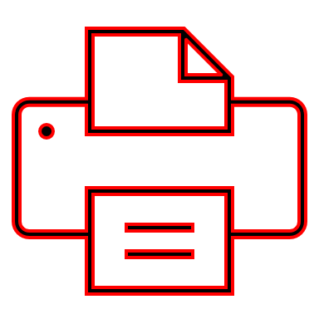
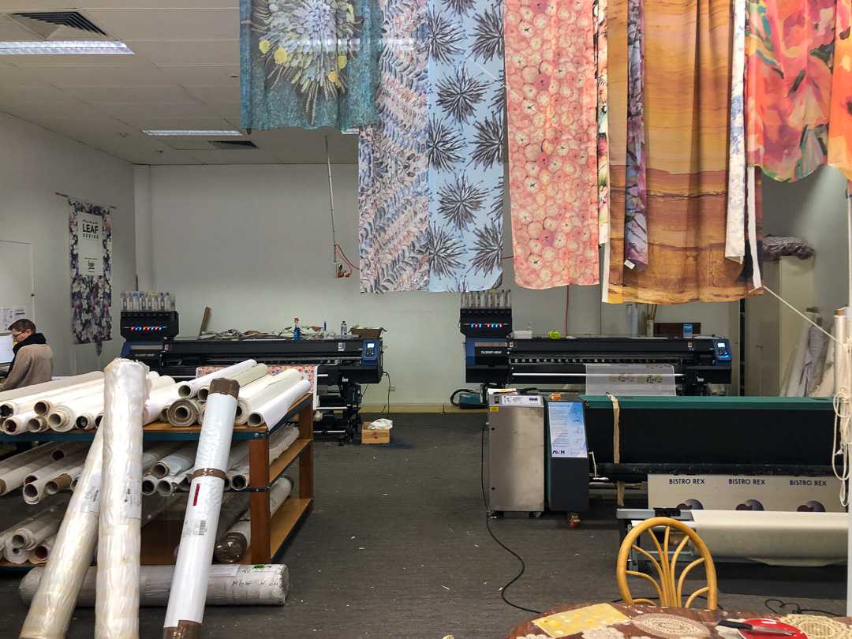
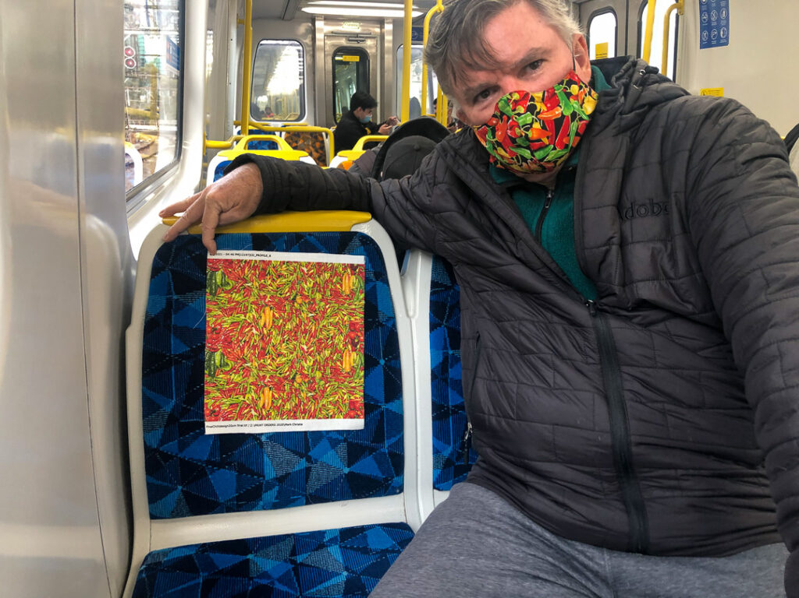
Photoshop and Libraries
Check and set your canvas output setting
Your cloth print width (140cm)
Your shirt material height (84cm for a 2XL plus extra 1cm for seams)
Clean up edges and reflections (things that might stand out too much)
Determine edge colour (black, sunset, dark green, yellow)
Make sure no deleted areas will appear as white if you have a coloured background
Create the seamless pattern
Consider if the seamless pattern has space between pattern elements to allow for sowing seams or other techniques are used to create the seamless art across the centre buttons.
To Print Company to print cloth
Assets
Frankie and Swiss | Custom Fabric Printing | Test Print Your Design
Notes:
The design of the pattern takes the most time and my intention was always to create a seamless pattern across the cloth using chilis. This involved taking one of my photographs and creating a seamless background and then placing individual larger chilis in the spaces created by separating the photograph into 4 pieces to create the seamless structure.
When you have done that... ideate in Dimension.
Without doing any cleanup of the photographs I was able to import them into Adobe dimension and place those images onto 3D models of shirts which I had obtained from Adobe stock.
Let’s look at how I did this.
----------------------
This gave me a chance see which colour combinations combined with the relative size of the fruit and the choice of background for the material.
This meant that I could select the best images and only clean up around the edges of those photographs which I have selected as choices from seeing them in Adobe dimension.
In Photoshop I had to consider the following:
Check and set your canvas output setting
Your cloth print width (140cm)
Your shirt material height (84cm for a 2XL plus extra 1cm for seams)
Clean up edges and reflections (things that might stand out too much)
Determine edge colour (black, sunset, dark green, yellow)
Make sure no deleted areas will appear as white if you have a coloured background
Create the seamless pattern
Consider if the seamless pattern has space between pattern elements to allow for sowing seams or other techniques are used to create the seamless art across the centre buttons.

Slide 7
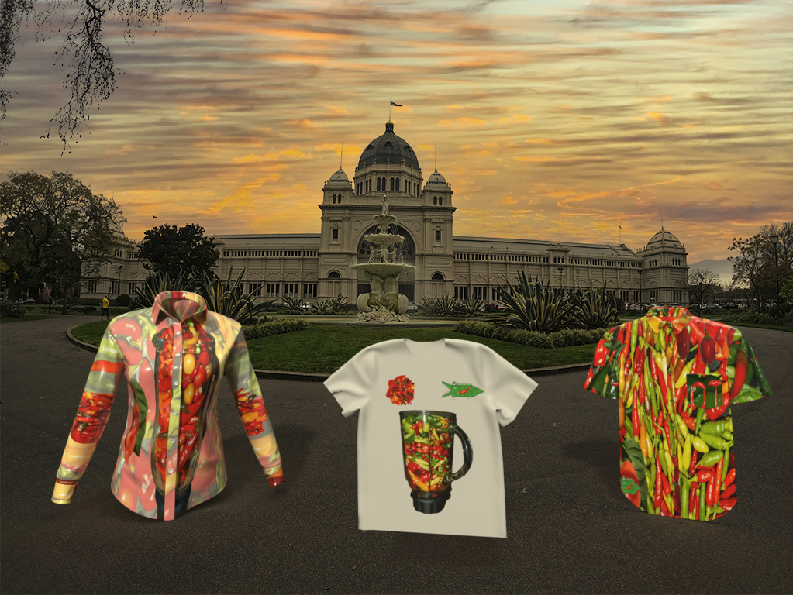
Stock and Dimension
Adobe Stock has paid and free 3D assets which you can use in Dimension
Applying patterns to the shirts in Dimension with backdrops provides visual context to your designs
Consider doing this step before clean up to gain a quick idea of image size relativity on the surface you are applying it to
It also provides you with incentive when you see mockups of what you are trying to create
Use for websites, conceptualisation, marketing, Selection polling and surveys
Notes:
After creating the tile I reimported that back into Adobe dimension to see how it would look on the shirt. By knowing the height of cloth in centimetres required to make my shirt I was able to resize the tile to ensure that the size of the chilis was visible on the shirt to anyone walking towards me.
Let’s see how I did that.
-----------------------------
With the tile and elements within the tile determined, I was then able to save the file as a high-quality export and send that off to the fabric printer to create a swatch. It is a good idea to print your design on a fabric swatch so you can see how the colours and the material work together for what will become an iconic Hawaiian chili shirt.
Here are some of the samples.

Slide 8
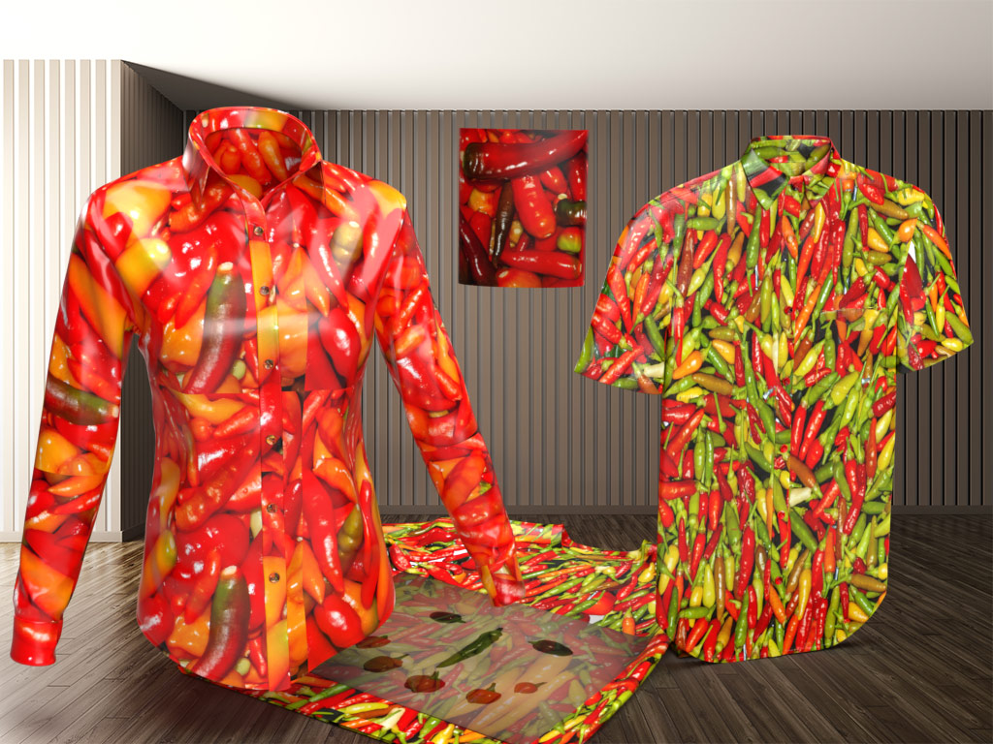
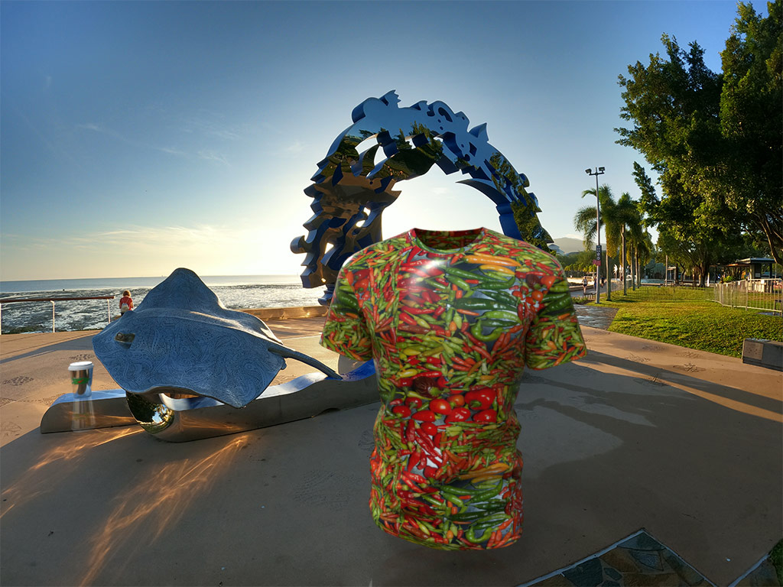
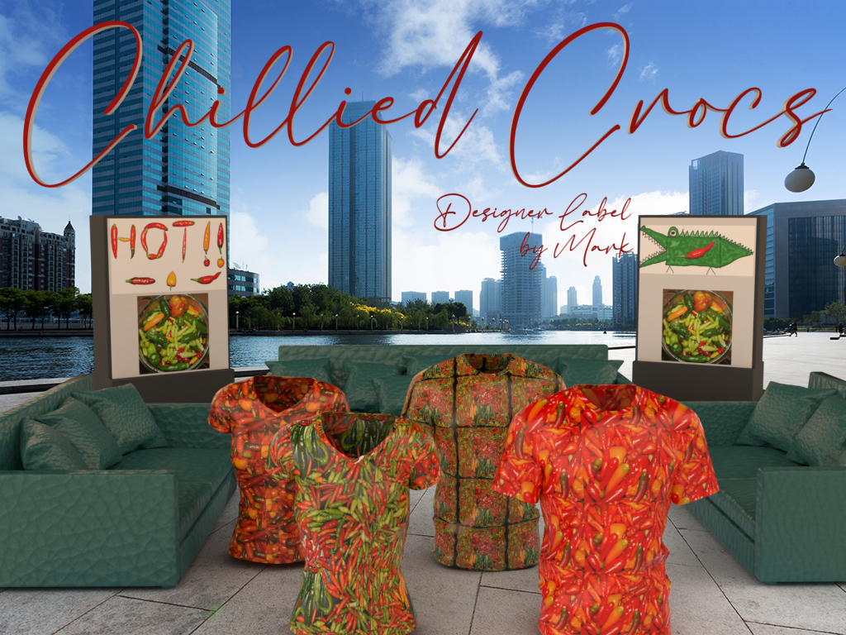
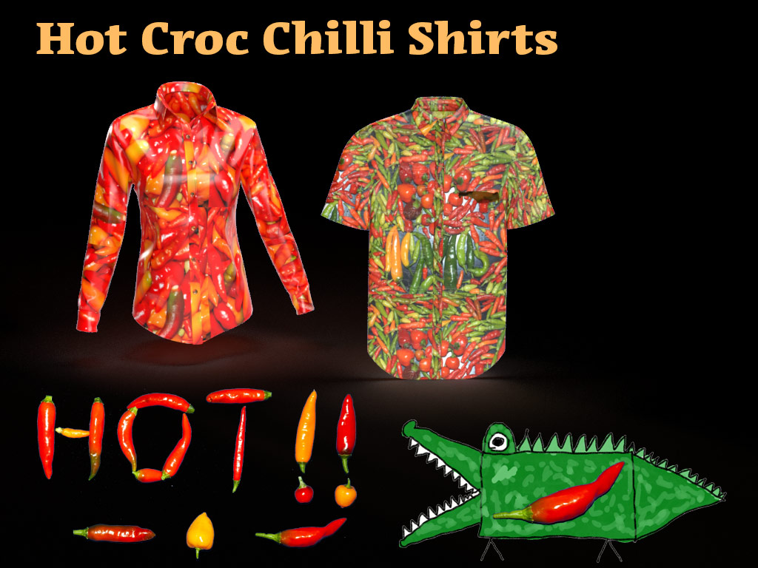
Dimension
This was so much fun, quick and easy… Here are some of my samples for this project
Notes:
You can of course printout swatches on paper and I would recommend this as it is cheaper for initial experiments however will not provide you with a realistic representation of what your final product will look like.
My first swatch highlighted to me that the size of my chilis are too small.
-----------------
It is important to work with your printer company and tailor to understand the size and quality of the material you will be receiving back and the cloth cuts required to make your shirt. In my case the cloth width is 140 cm and the height required for a 2XL shirt is 87 cm.

Slide 9
Fresco and Art Hub for Kids
I wanted an abstract, organic logo that reflected the Northern Territory and Chillies with an edgy, dangerous theme
I can’t draw or paint
BUT
Combining Art Hub for Kids free follow along lessons, I created my own “Hot Chilli Croc” logo…
It is uniquely mine, even if it is the product of following a kindergarten drawing lesson and combining variations of two more famous logos
https://youtu.be/5tHq9o9nFXo
Notes:
Having determined, designed and prepared my chili tiles or swatches, I was now ready to design my logo. This is also an exercise in ideation. My primary challenge is that I don’t know how to draw so for this I called upon the art for kids hub YouTube channel to provide me with technical guidance and inspiration so decided on a cartoon crocodile with a chilli in its stomach.
I decided to use Adobe Fresco to create my organic looking crocodile and here is how I did that.
-------------------
At this stage I still haven’t got my Hawaiian shirt. However I am but a single step away from ordering the fabric required to make it. More importantly my process of ideation has delivered me the steps and pragmatic information I need to sidestep some of the problems I could have faced if I hadn’t engaged the use of the Adobe products before committing to fabric printing.

Slide 10
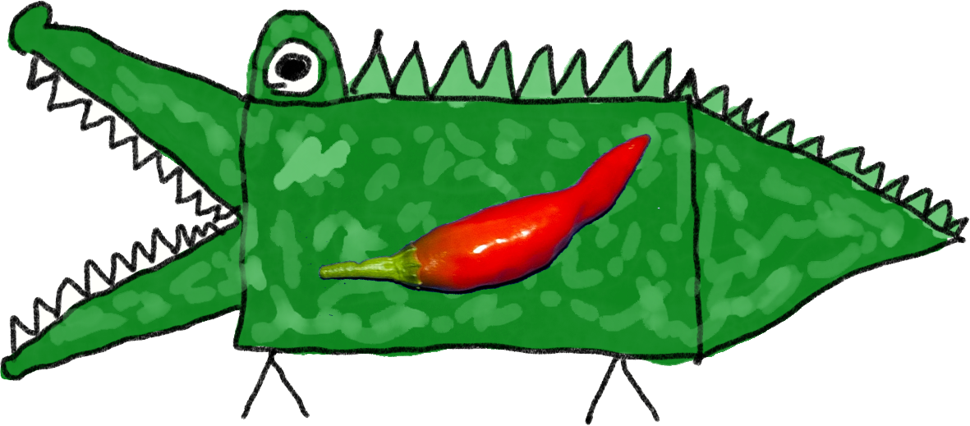
The Way… Also known as ”Process Flow” – “Swim Lanes”
Import and tag photos. Flag best picks
Store in Collection
Export picks to CC Library folder
Store in Library
2
1
Clean up images. Keep at best resolution
Create empty file with correct sizing for print
Create Seamless pattern types
Edit backdrop photos. Replace Sky (Optional)
Finish Logo in Photoshop (Optional)
Source 3D shirt model to place pattern on
Agree Final Design
Add 3D model, background, patterns
Background, lights, text
Change patterns, render, share
Inspiration, guidance – Art for Kids Hub
Create your logo – use many layers
Export both movie and PSD
Print on A4 paper to start
Print cloth swatches to test materials
Print cloth material for shirt
Make Shirt
Document your plan
Document your Design and Journey
Share your Design and Journey
Notes:
So let me recap the workflow used to get this far using this process flow or swimlane chart as it is also known..
On the left are the applications and tools used in the process. By the way the PowerPoint of this is available if you want to adapt your own work flow into a diagram that works as a roadmap for your students.
At many points along the journey of ideation and creation, substitute whatever works for you or your students. Photographs of aeroplanes could be substituted for chilis. Cushions or tablecloths could be substituted for a Hawaiian shirt. Seamless pattern tiles could be replaced by logos or poster images. In my case I start by capturing images
Collect, sort, refine and select…
The process of collecting assets into a tool like Lightroom before making a selection of the best of the best is a good starting point for these kinds of projects. Tagging your photographs with keywords, adding to a collection, exporting or identifying the best images for your project sets you up for the next stage.
Ideation and creation
Editing and refining your images into either seamless tiles or standalone works of art to be incorporated into their final destination is where the image editing tools such as photoshop, Illustrator and Fresco help shape your idea into a final product. Tools like Adobe dimension help you visualise what the final product will look like before you commit to creating the printed material. Adobe Stock can provide imagery or 3D models to support your ideation process.
Fresco helped me not only ideate, but create something I drew, drawing upon many inputs to have something uniquely mine to share.
Finalising your output
Printing swatches to paper or cloth before committing to the printed pattern on metres of material is what comes next before tailoring your shirt.
Spark Page and other tools
Documenting your process, prototypes can be done in a number of locations using a variety of tools. It occurs parallel to your activity and can also serve as evidence of teaching, learning and participation. Spark page is an excellent choice for this journaling process.

Slide 11
Spark
Document the “How to” in Spark
I used PowerPoint and WordPress to document this story, however Spark Page allows me to package this up as a web page experience, a PDF file or embedded into MS Teams for student and teacher consumption.
I am yet to decide on my final print for the 2 metres of printed material I need, but at this stage it will probably be similar to what you see above.
Notes:
In finalising this presentation into a spark page, there have been a number of intermediate steps along the way. These included PowerPoint, Word and dictation software.

Slide 12
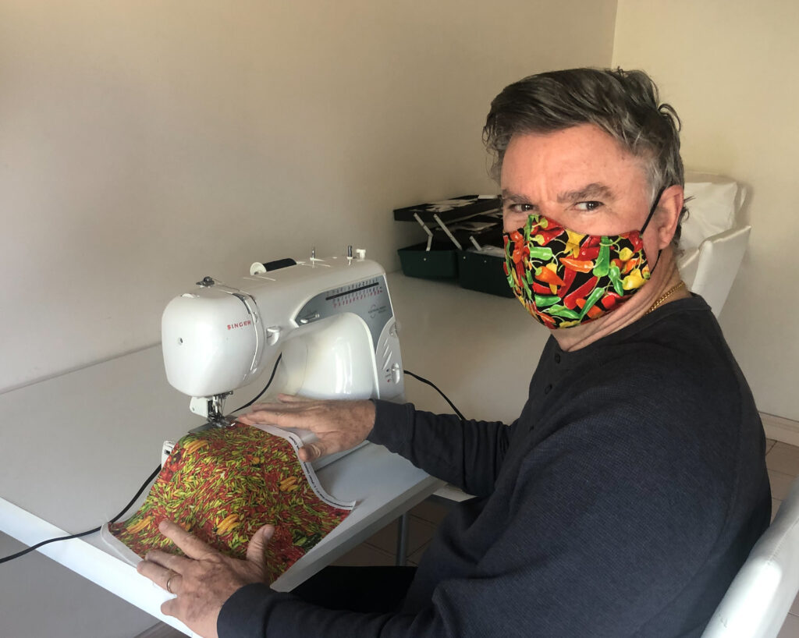
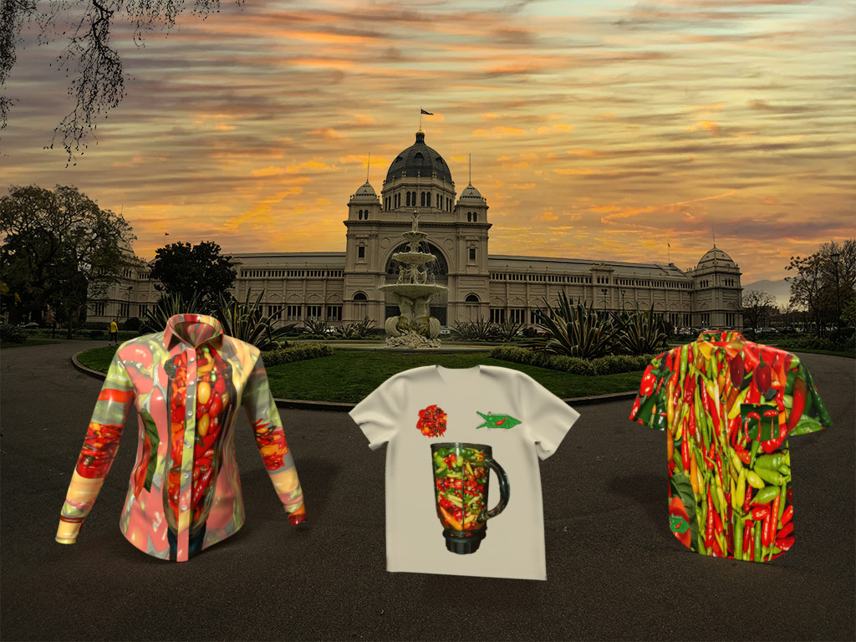
Notes:
At this stage I still haven’t got my Hawaiian shirt. However I am but a single step away from ordering the fabric required to make it. More importantly my process of ideation has delivered me the steps and pragmatic information I need to sidestep some of the problems I could have faced if I hadn’t engaged the use of the Adobe products before committing to fabric printing.

Slide 13
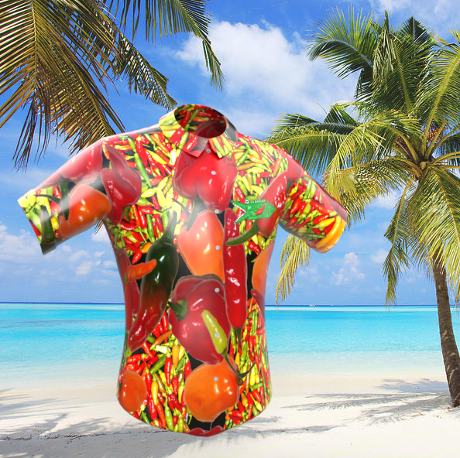
My final design…
Notes:
In finalising this presentation into a spark page, there have been a number of intermediate steps along the way. These included PowerPoint, Word and dictation software.
Although the combined material when presented takes longer than the 15 minutes I’m allowed, my spark page allows you to go and spend more time if that’s interesting in working through the resources. All the links and details of this process are available in the following blog post.

Slide 14
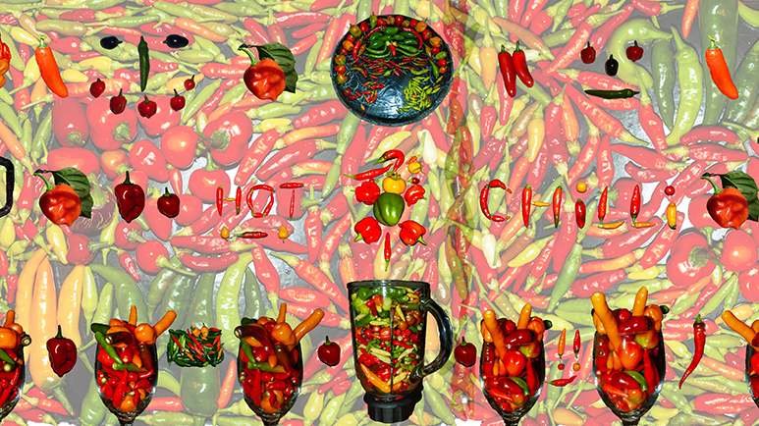
THE END… …or is it?
Notes:
It also gives me confidence that educators and students alike can adapt this process for their own purposes. Ideation might be about the creation of ideas but the journey of ideation delivers rich learning to the individual as well. Ideate, create and promulgate. Thank you.
Markc@xsymetrix.com.au

